Slide 1


SOFTWARE DESIGN PRINCIPLES
Why Good Design Matters in Software Development
Catalogue Number

Slide 2

Objectives
What we will learn today:
Understand key software design principles
SOLID
DRY
KISS
YAGNI
Learn to write maintainable, scalable, and readable code
Techniques for simplicity in software design
Techniques for avoiding Over-Engineering
Apply principles with real-world examples and exercises

Slide 3

Introduction – What is Software Design?
Software Design
The process of creating a blueprint for software
Importance
Reduces technical debt
Facilitates collaboration
Simplified future upgrades

Slide 4
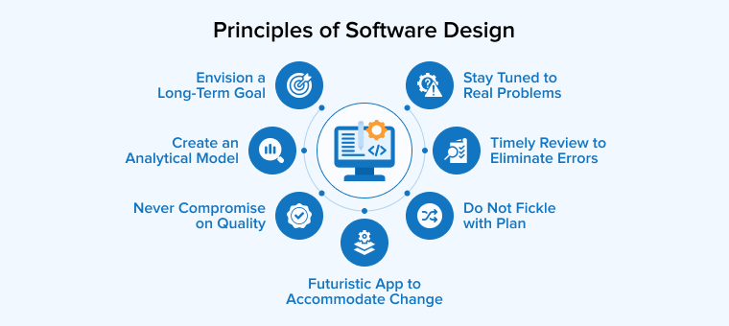
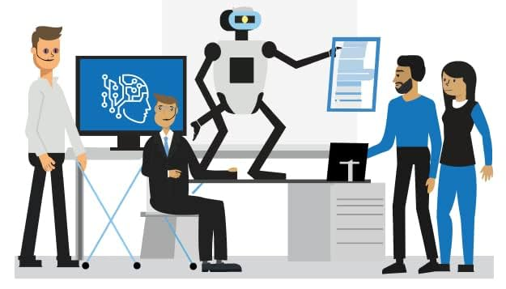
Software Design Principles
General guidelines and best practices that are used to create software that is maintainable, scalable, and efficient.
Ensure the code is maintainable, scalable, testable, and easy to understand, reducing technical debt, enabling collaboration, and making the software adaptable to future changes.
Faster development, fewer bugs, improved security, and a better user experience, ensuring the software remains robust throughout its lifecycle.

Slide 5
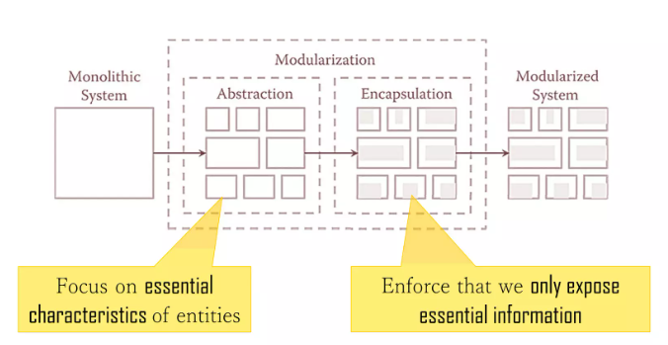
Software Design Principles (Cont’d…)
SOLID
DRY
KISS
YAGNI
Modularity
Abstraction
Encapsulation
Cohesion
Loose Coupling
GRASP (General Responsibility Assignment Software Patterns)
CQS (Command-Query Separation)
Law of Demeter (Principle of Least Knowledge)
Single Source of Truth (SSOT)
Separation of Command and Query Responsibility (CQRS)
Tell, Don’t Ask
Dependency Injection (DI)

Slide 6
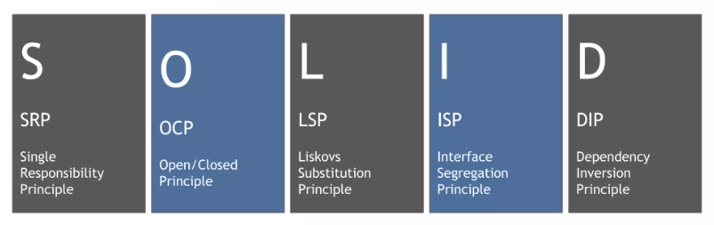
SOLID

Slide 7
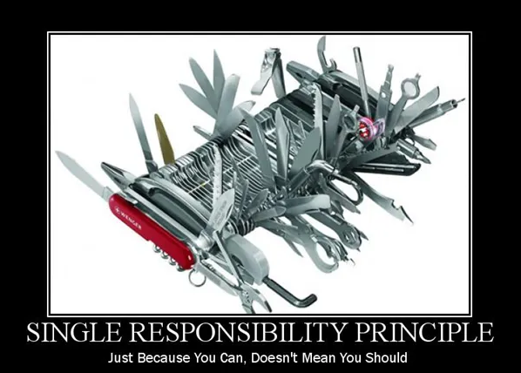
Single Responsibility Principle (SRP)
“A class should have one and only one reason to change, meaning that a class should have only one job.”
# Bad
class User:
def save_to_db(self):
# ...
def generate_report(self):
# ...
# Good
class User:
def save_to_db(self):
# ...
class ReportGenerator:
def generate_report(self, user):
# ...

Slide 8
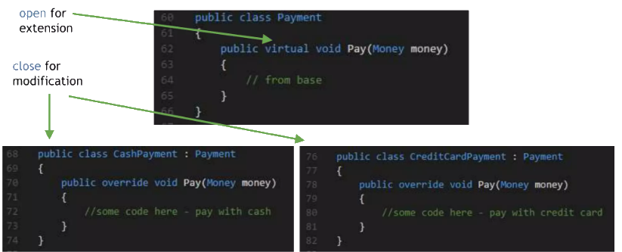
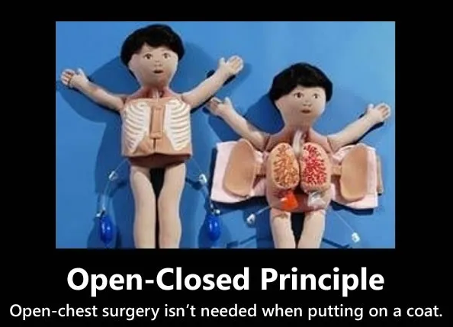
Open-Closed Principle (OCP)
“Objects or entities should be open for extension but closed for modification.”
# Bad
class Rectangle:
# ...
class AreaCalculator:
def calculate_area(self, rectangle):
return rectangle.width * rectangle.height
# Good
class Shape:
def area(self):
pass
class Rectangle(Shape):
def area(self):
return self.width * self.height
class Circle(Shape):
def area(self):
return 3.14 * self.radius ** 2
class AreaCalculator:
def calculate_area(self, shape):
return shape.area()

Slide 9
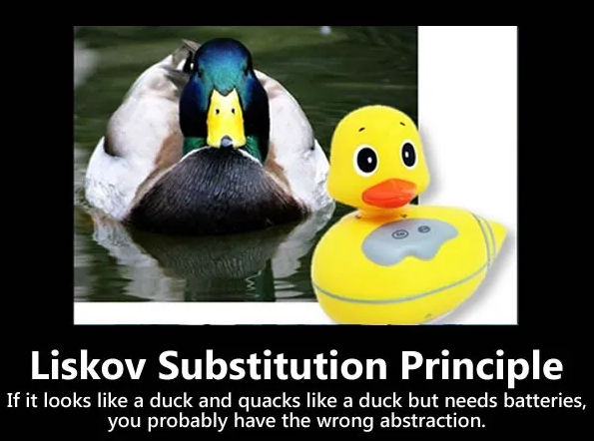
Liskov Substitution Principle (LSP)
“Objects in a program should be replaceable with instances of their subtypes without altering the correctness of that program.”
# Bad
class Bird:
def fly(self):
# ...
class Penguin(Bird):
def fly(self):
raise Exception("Can't fly")
# Good
class Bird:
def move(self):
# ...
class FlyingBird(Bird):
def fly(self):
# ...
class SwimmingBird(Bird):
def swim(self):
# ...

Slide 10
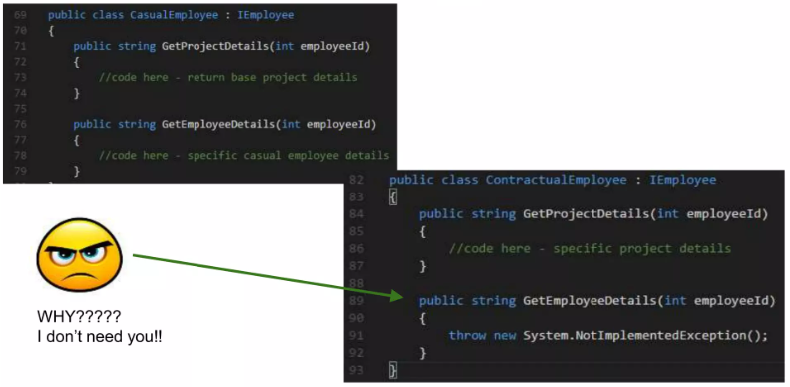
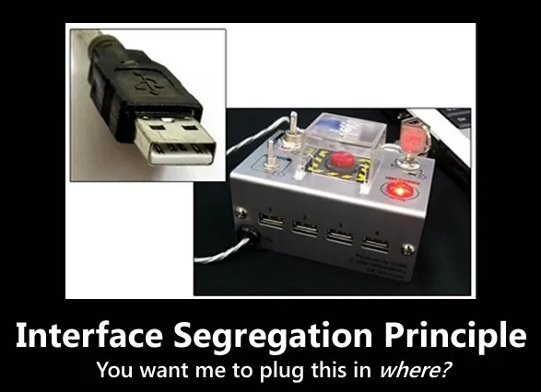
Interface Segregation Principle(ISP)
“Many client-specific interfaces are better than one general-purpose interface.”
# Bad
class Worker:
def work(self):
# ...
def eat(self):
# ...
# Good
class Workable:
def work(self):
# ...
class Eatable:
def eat(self):
# ...
class Worker(Workable, Eatable):
# ...

Slide 11

Dependency Inversion Principle (DIP)
# Bad
class LightBulb:
def turn_on(self):
# ...
class Switch:
def __init__(self, bulb):
self.bulb = bulb
def operate(self):
self.bulb.turn_on()
# Good
class Switchable:
def turn_on(self):
pass
class LightBulb(Switchable):
def turn_on(self):
# ...
class Switch:
def __init__(self, device: Switchable):
self.device = device
def operate(self):
self.device.turn_on()
“High-level modules should not depend on low-level modules. Both should depend on abstractions.”

Slide 12
Quiz
Which principle states that a class should have only one reason to change?
Open-Closed Principle
Single Responsibility Principle
Liskov Substitution Principle
Interface Segregation Principle
The Open-Closed Principle suggests that software entities should be:
Open for modification but closed for extension
Closed for modification but open for extension
Both open for modification and extension
Neither open for modification nor extension
Which principle deals with ensuring that objects of a superclass can be replaced with objects of its subclasses without affecting program correctness?
Dependency Inversion Principle
Interface Segregation Principle
Liskov Substitution Principle
Single Responsibility Principle

Slide 13
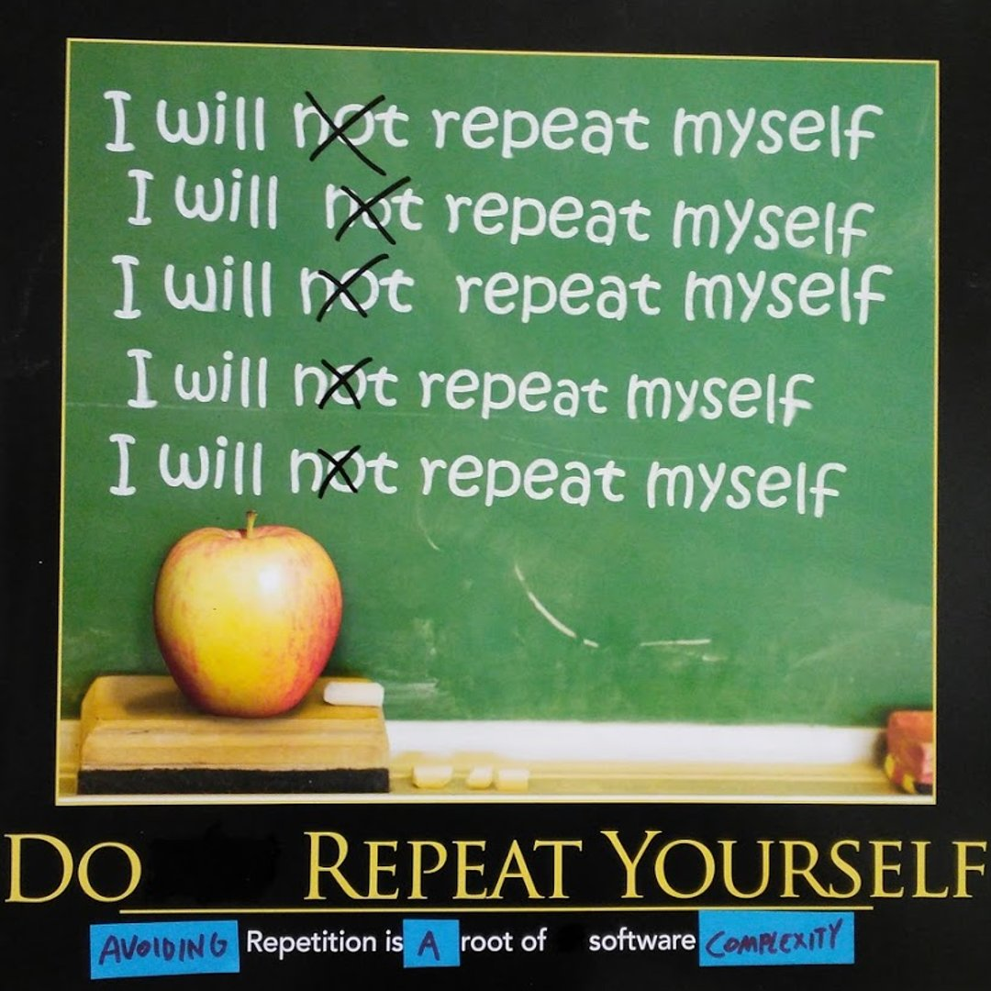
DRY – Don’t Repeat Yourself
This principle states that each small pieces of knowledge (code) may only occur exactly once in the entire system.
Every piece of knowledge or logic should have a single, unambiguous representation in the system.
Avoid code duplication.
Use abstraction to centralize common functionality

Slide 14
DRY - Example
# Bad
def validate_email(email):
# Email validation logic
# ...
def register_user(email):
# Email validation logic (repeated)
# ...
# Register user
# ...
# Good
def validate_email(email):
# Email validation logic
# ...
def register_user(email):
if validate_email(email):
# Register user
# ...
Centralized data models: Use a single model for similar data structures
Template engines: Use templates to generate repetitive SQL queries
Single source of truth: Maintain authoritative data definitions centrally
Helper classes: Use helper classes in enterprise libraries where every piece of code is unique
Benefits include: Saving time and effort, Making code easier to maintain, and Reducing the chances of bugs.

Slide 15
QUIZ
Refactor according to DRY Principle
import math
def calculate_circle_area(radius):
return math.pi * radius ** 2
def calculate_circle_circumference(radius):
return 2 * math.pi * radius
def print_circle_info(radius):
print(f"Area: {calculate_circle_area(radius)}")
print(f"Circumference: {calculate_circle_circumference(radius)}")
def calculate_circle_area(radius):
return 3.14 * radius * radius
def calculate_circle_circumference(radius):
return 2 * 3.14 * radius
def print_circle_info(radius):
print(f"Area: {3.14 * radius * radius}")
print(f"Circumference: {2 * 3.14 * radius}")

Slide 16
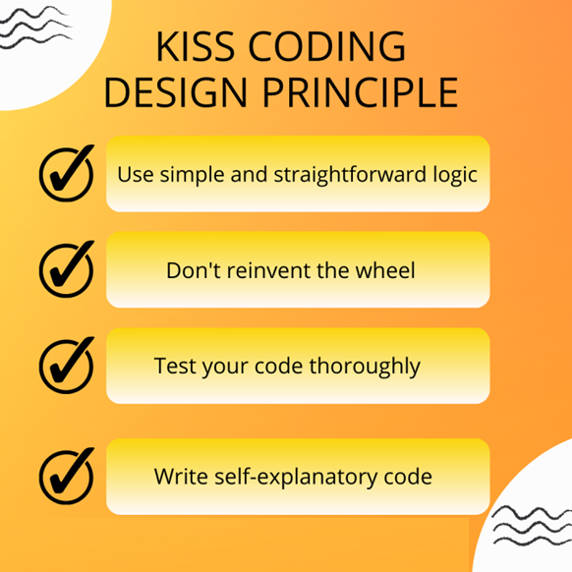
KISS – Keep It Simple, Stupid
This principle states that try to keep each small piece of software simple and unnecessary complexity should be avoided.
Simplicity should be a key goal in design.
Simple code is easier to understand, maintain, and debug.
Essentially, keep methods small <20 lines and at most have 4 parameters.

Slide 17
KISS - Example
# Over-engineered solution using Strategy pattern
class Operation:
def execute(self, a, b):
pass
class Addition(Operation):
def execute(self, a, b):
return a + b
class Subtraction(Operation):
def execute(self, a, b):
return a - b
op = Addition()
print(op.execute(5, 3))
Avoiding Over-Engineering
Use Built-in Functions Instead of Reinventing the Wheel
Avoiding Unnecessary Configurations
Simple Conditional Logic
Avoiding Premature Optimization
Clear Naming and Avoiding Abstraction Where Unnecessary
The KISS Principle reminds us that simple solutions are often the best solutions. By avoiding unnecessary complexity, you make code easier to maintain, test, and understand—saving time and reducing errors in the long run.
# Simple solution following KISS principle
def add(a, b):
return a + b
print(add(5, 3))

Slide 18
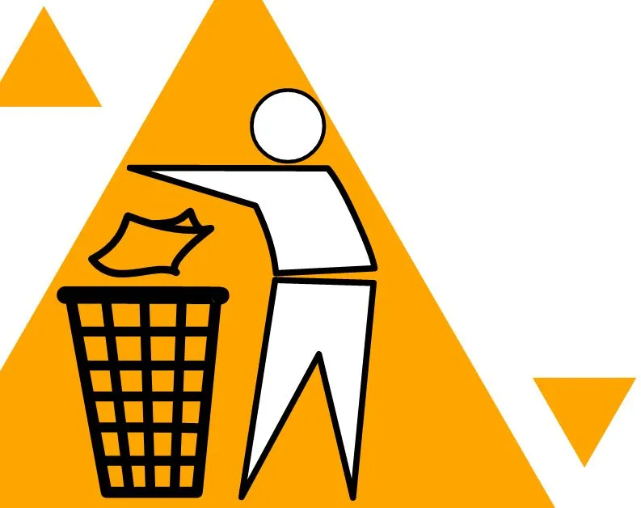
YAGNI – You Ain’t Gonna Need It
This principle states that always implement things when you actually need them never implements things before you need them.
Don't add functionality until it's necessary.
Avoid implementing features you think you may need in the future.
Focus on current requirements to prevent overengineering.
Benefits:
Simpler code that's easier to understand and maintain
Faster development of essential features
Reduced risk of introducing bugs in unused features
Flexibility to implement future features based on actual needs rather than speculation

Slide 19
YAGNI - Example
Following the YAGNI principle.
Let's consider a simple user registration system for a website. The current requirement is to allow users to register with a username and email.
class User:
def __init__(self, username, email):
self.username = username
self.email = email
class UserRegistration:
def register_user(self, username, email):
if self.is_valid_input(username, email):
user = User(username, email)
self.save_to_database(user)
return user
else:
raise ValueError("Invalid username or email")
def is_valid_input(self, username, email):
# Simple validation
return username and "@" in email
def save_to_database(self, user):
# Code to save user to database
pass
# Usage
registration = UserRegistration()
new_user = registration.register_user("john_doe", "john@example.com")
In this example, the developer anticipates future features that haven't been requested yet, violating the YAGNI principle.
class User:
def __init__(self, username, email):
self.username = username
self.email = email
self.premium_member = False
self.login_attempts = 0
self.last_login_date = None
self.preferences = {}
class UserRegistration:
def register_user(self, username, email):
# Validate username and email

Slide 20

Group Discussion
"You're developing a user registration system for a website. A team member suggests implementing a feature that allows users to link multiple email addresses to their account, arguing that it might be useful in the future.“
Discussion Points:
How does this scenario relate to the KISS and YAGNI principles?
What would you recommend and why?
What questions would you ask to make a more informed decision?

Slide 21
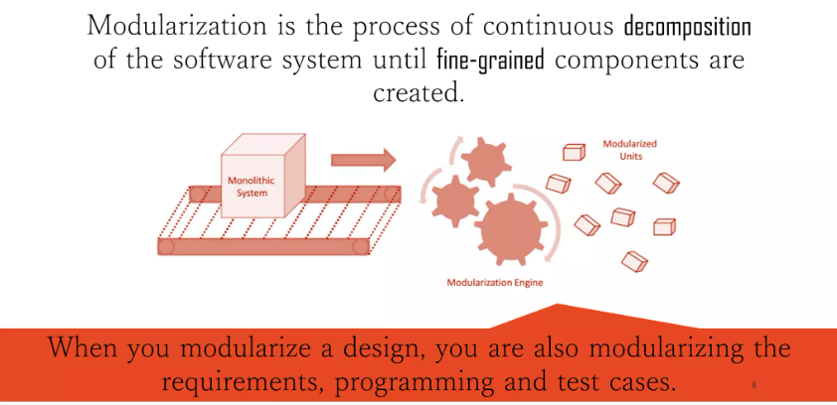
Modularization

Slide 22
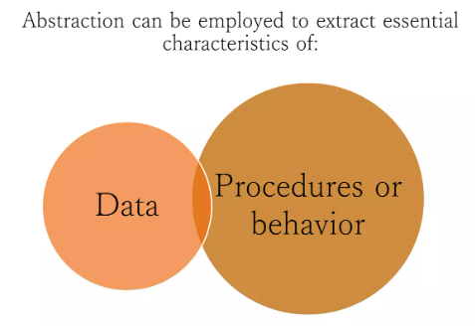
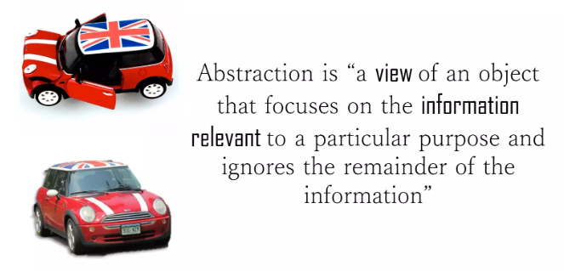
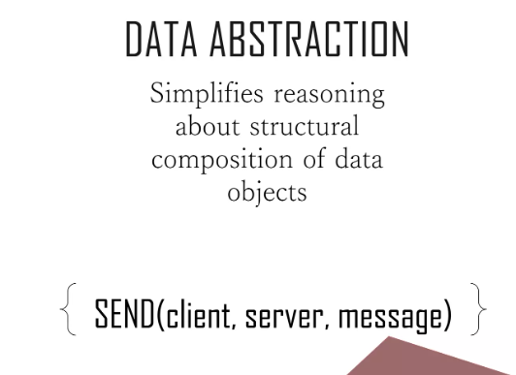
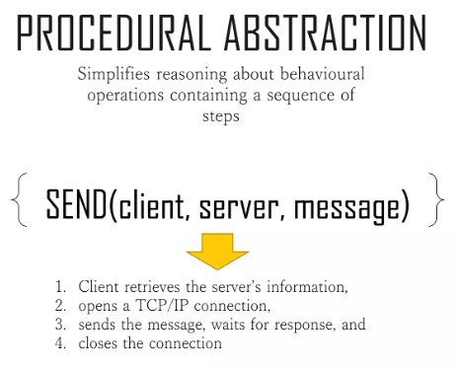
Abstraction

Slide 23
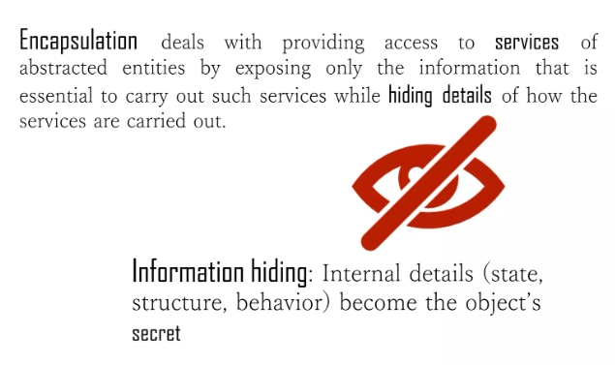
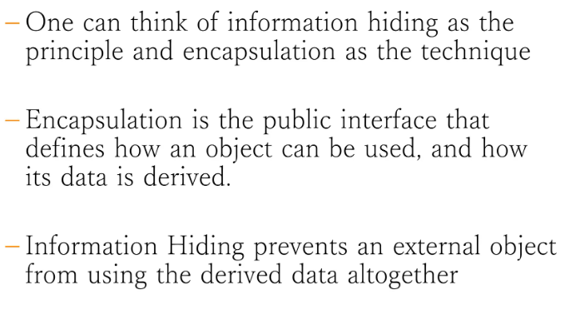
Encapsulation and Information Hiding

Slide 24

Modularization, Abstraction and Encapsulation

Slide 25
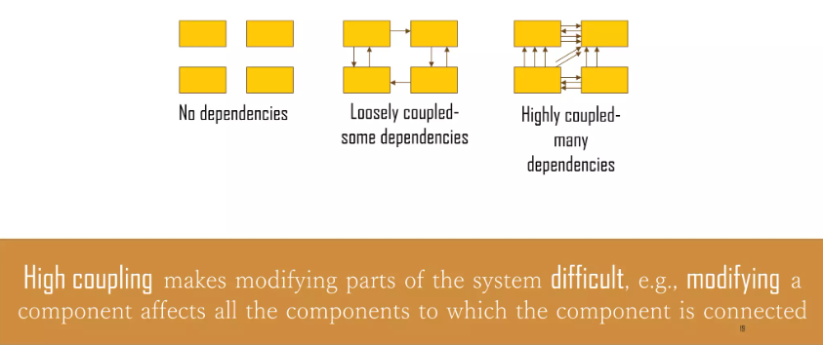
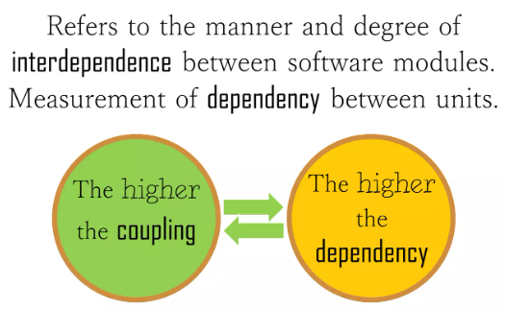
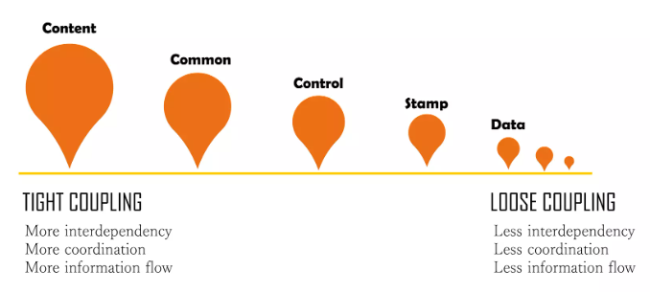
Coupling

Slide 26
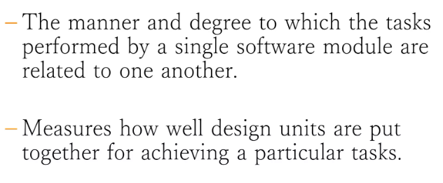
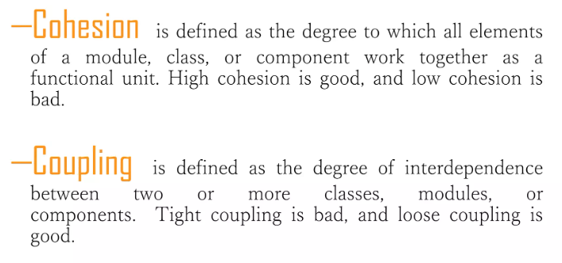
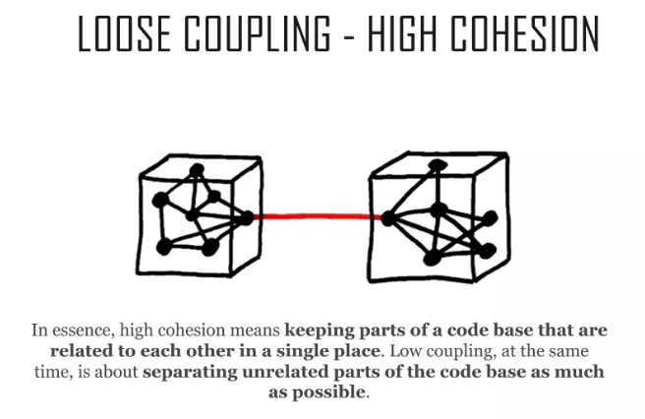
Cohesion

Slide 27

Questions

Slide 28


